Slide 1


Learning the Language of HTTP for Better Data Experience
CHRIS WOODRUFF

Slide 2

Chris Woodruff
cwoodruff@live.com
Twitter – @cwoodruff

Slide 3
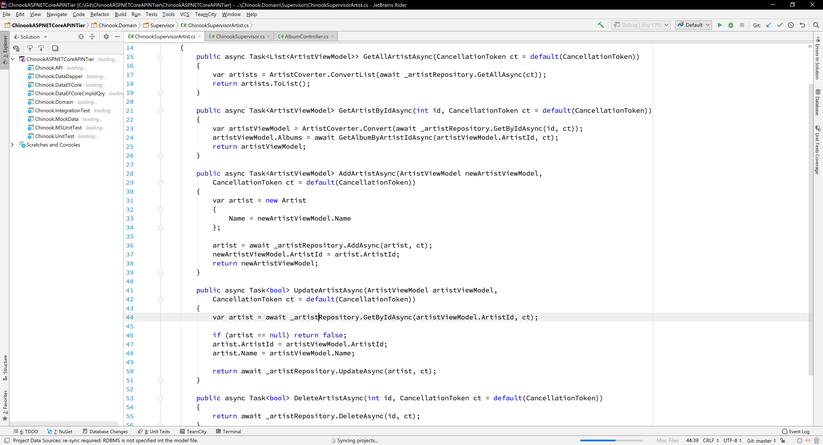


Slide 4

Where did we come from?

Slide 5
Types of Web Services
01
Remote Procedure Call (RPC)
02
Simple Object Access protocol (SOAP)
03
Representational State Transfer (REST)
Calls over HTTP
04

Slide 6
Evolution of Services

Slide 7

Understanding the HTTP Protocol

Slide 8
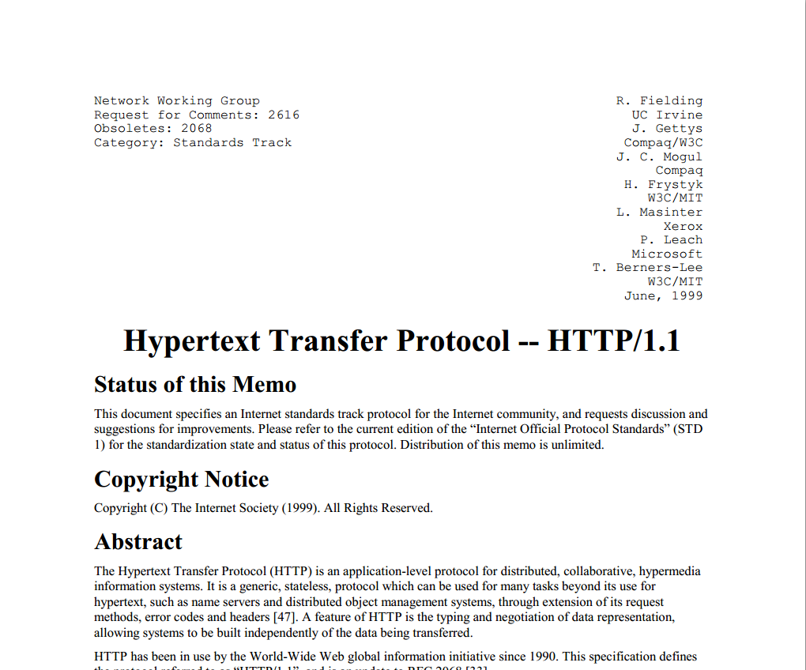

Slide 9
What you need to know about HTTP
HTTP Methods or Verbs
Request Header
Request Body
Response Codes
Response Header
Response Body

Slide 10
Initiates
Interaction
Responds to
Interaction

Slide 11
HTTP Methods or Verbs
GET
POST
PUT
DELETE
HEAD
Queries the representation of a resource
Changes the state of a resource
Produces new or replaces content of existing resource
Deletes resource
Same as GET but without the response body

Slide 12
HTTP Methods or Verbs
PATCH
TRACE
OPTIONS
Applies partial modifications to a resource
performs a message loop-back test to the target resource
Determine options and/or requirements associated with a resource (Cross-Origin Requests)
CONNECT
establishes a tunnel to server identified by target resource (SSL)

Slide 13
HTTP Request
Includes HTTP Verb
And Metadata
includes data you want to transfer
(text, pics, HTML, json)

Slide 14
HTTP Request Header
From: cwoodruff@live.com
User-Agent: HTTPTool/1.0
Accept: text/html
Accept-Encoding: gzip, deflate
Content-Length: 348
Content-Type: application/json

Slide 15
HTTP Request Examples
GET
POST
GET /path/index.html HTTP/1.1
Host: www.chriswoodruff.com
From: cwoodruff@live.com
User-Agent: Mozilla/5.0 (Windows NT 6.1) AppleWebKit/537.36 (KHTML, like Gecko) Chrome/41.0.2228.0 Safari/537.36
Accept: text/html
POST /path/index.html HTTP/1.1
From: cwoodruff@live.com
User-Agent: HTTPTool/1.0
Content-Type: text/html
Content-Length: 3200

Slide 16
HTTP Response Codes
1XX
2XX
3XX
4XX
5XX
Information responses
Successful responses
Redirection messages
Client error responses
Server error responses

Slide 17
Common Response Codes
200
202
204
201
304
307
308
400
401
403
405
409
404
406
500
501
503
504
Notes:
200 OK
201 Created
202 Accepted
204 No Content
301 Moved Permanently
304 Not Modified
307 Temporary Redirect
308 Permanent Redirect
400 Bad Request
401 Unauthorized
403 Forbidden
404 Not Found
405 Method Not Allowed
407 Proxy Authentication Required
500 Internal Server Error
501 Not Implemented
503 Service Unavailable
504 Gateway Timeout

Slide 18
HTTP Response
Includes Response Code
And Metadata
includes data the API want to transfer back
(text, pics, HTML, json)

Slide 19
HTTP Response Header
HTTP/1.1 200 OK
Date: Tue, 9 Sep 2018 08:12:31 GMT
Content-Encoding: gzip
Content-Length: 348
Cache-Control: max-age=3600
Server: Apache/2.4.1 (Unix)
Allow: GET, HEAD

Slide 20
HTTP Response Examples
200
404
HTTP/1.1 200 OK
Date: Fri, 3 Aug 2018 23:59:59 GMT
Server: Apache/2.2.14 (Win32)
Last-Modified: Wed, 22 Jul 2020 19:15:56 GMT
Content-Length: 88
Content-Type: text/html
Connection: Closed
HTTP/1.1 404 Not Found
Date: Mon, 3 Aug 2018 23:59:59 GMT
Server: Apache/2.2.14 (Win32)
Content-Length: 230
Connection: Closed
Content-Type: text/html; charset=iso-8859-1

Slide 21

Understanding REST

Slide 22
Representational State Transfer?
The Client references a resource using a URL
A representation of the resource is returned
When the Client selects a hyperlink in the resource it accesses another resource
The new representation places the Client in a different state
Thus, the Client transfers state with each resource representation.

Slide 23
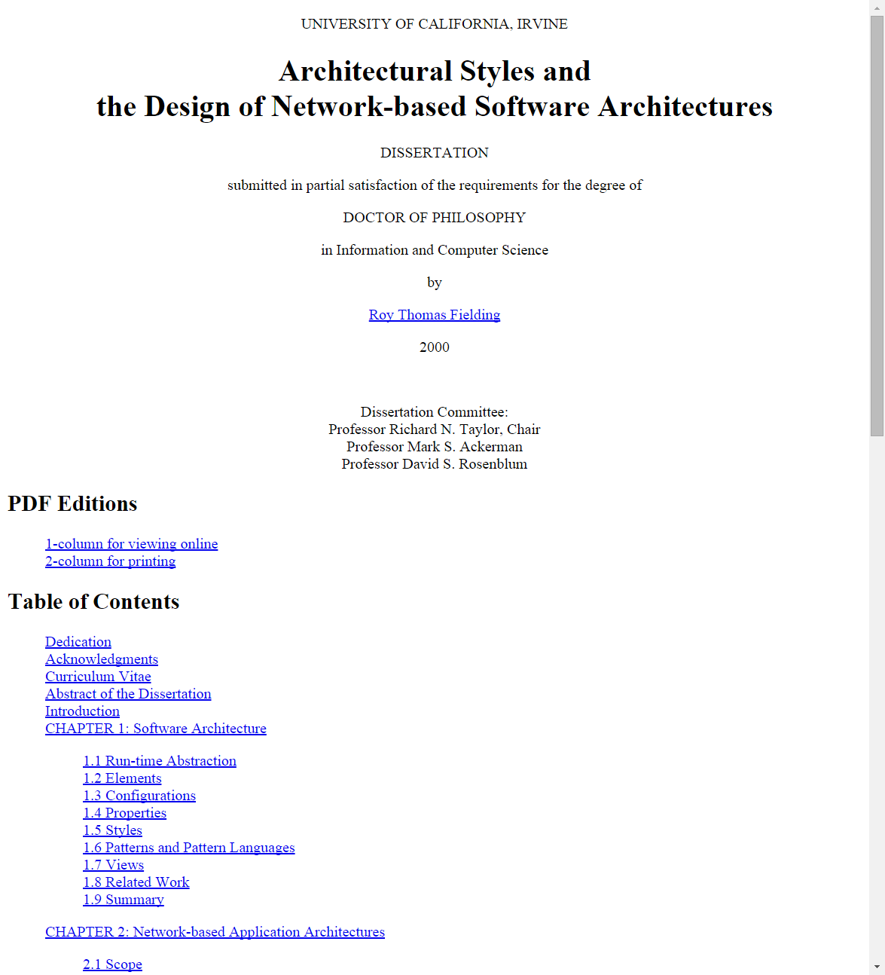

Slide 24
WHAT IS REST?


RESOURCES
URL

VERBS

Slide 25
RESTful
web services try to leverage HTTP in its entirety using specific architectural principles

Slide 26
2 common perspectives on architectural design
Designer starts with nothing (blank) and builds an architecture from familiar components
Designer starts with the system and applies constraints to elements of the system
REST!!!!

Slide 27
REST Constraint #1
Client-server Architecture
A server component offering services, listens for requests upon these services. A client component desires that a service be performed, sends a request to the server via a connector.
This separation allows for the two components to evolve independently, which increases scalability.

Slide 28
REST Constraint #2
Stateless Communication
Each request from the client must contain all necessary information to understand the request.
This constraint induces:
Visibility – need to look at only one request to get the full nature of the request
Reliability – eases the task of recovering from failures
Scalability – not having to store data between requests allows the server to free resources

Slide 29
REST Constraint #3
Caching
Cache constraints require that the data within a response to a request be labeled as cacheable or non-cacheable. If a response is cacheable, a client cache is given the right to reuse the response data for later, equivalent requests.
Cache constraints eliminate some interactions and improve efficiency and scalability. Cache can decrease reliability because of stale data.

Slide 30
REST Constraint #4
Uniform Interface
Identification of Resources
  A resource is any information that can be named. An example of a resource is the current price stock prices on Nasdaq. Resource identification requires the same authority who maintains the reference to a resource to also be responsible for preserving meaning of that resource.

Slide 31
REST Constraint #4
Uniform Interface
Manipulation of Resources through Representations
  The resources must be manipulated via representations. A client has no access to a resource directly, it can only send and receive representations from the server. (An example of a representation is an html page with a PNG image of the current stock price during the trading day.)

Slide 32
REST Constraint #4
Uniform Interface
Self-descriptive Messages
  States that all messages must include metadata which describe the meaning of the message.
Hypermedia as the engine of application state
  The steps in a REST architecture must be invoked through hypermedia. More specifically, in order for an application’s process to move a step, it must invoke that next step from a reference inside the current representation.

Slide 33
REST Constraint #5
Layered System
Layered system style allows an architecture to be composed of hierarchical layers by constraining component behavior so each component cannot ‘see’ beyond the immediate layer with which they are interacting.
Layered system style helps reduce complexity and promote independence. Layers can be used to protect new services from legacy clients. They can also add overhead.

Slide 34
REST Constraint #6
Code on Demand
REST allows client functionality to be extended by downloading and executing code in the form of scripts

Slide 35
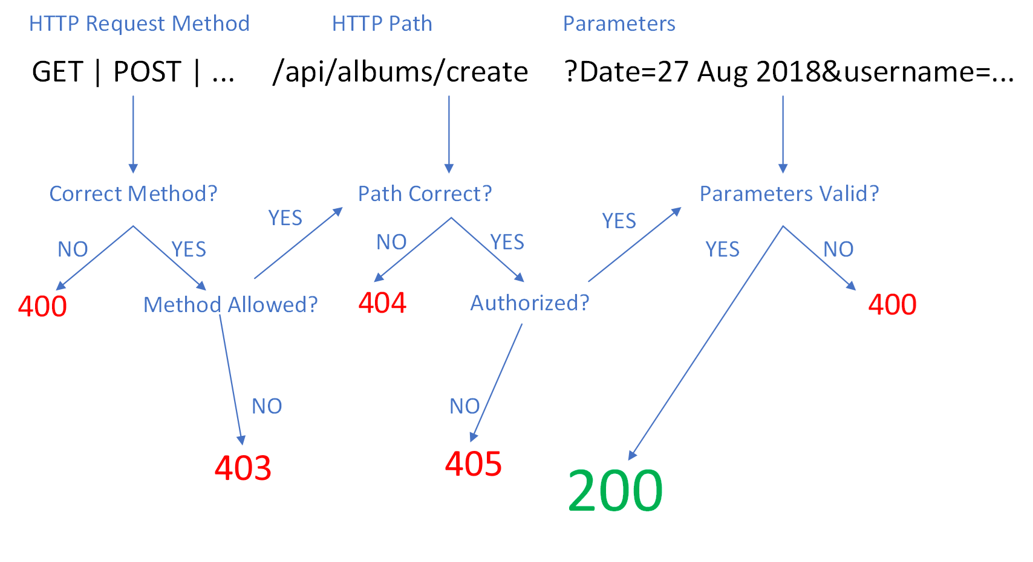
Workflow for an HTTP REST Request

Slide 36
REST Quiz
RESOURCE
VERB
EXPECTED OUTCOME
RESPONSE CODE
/Products
GET
A list of all products in the system
200 OK
/Products?Color=green
GET
A list of all products in the system where the color is green
200 OK
/Products
POST
Creation of a new product
201 Created
/Products/81
GET
Product with an ID of 81
200 OK
/Products/881
GET
No product with ID 881
404 Not Found
/Products/81
PUT
Update of the product with ID of 81
204 No Content
/Products/81
PUT
Update of the product with ID of 81
304 Not Modified
/Products/81
DELETE
Deletion of the product with ID of 81
204 No Content

Slide 37
Testing RESTful APIs

Slide 38
Tools that I use for testing APIs
Fiddler
Postman
Fiddler is an HTTP debugging proxy server application originally written by Eric Lawrence
Postman is a complete API development environment, for API developers. Postman is available for Mac OS X, Windows, and Linux users.
ASP.NET Core 2.1 Web API
JetBrains Rider/VSCode
Integration Testing
Editor-based REST client based on scratch files with the .http extension

Slide 39
What to remember to develop better APIs
Understand HTTP
Learn how to use HTTP Verbs
Learn how to use Response Codes
Understand REST
Learn how to test RESTful APIs

Slide 40


Slide 41
CHRIS WOODRUFF


SKYPE
CWOODRUFF
EMAIL
CHRIS.WOODRUFF@JETBRAINS.COM


THANK YOU
TWITTER
CWOODRUFF
PHONE
616.724.6885


LINKEDIN
CHRIS.WOODRUFF
WEBSITE
CHRISWOODRUFF.COM

